Slide 1

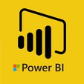
Hii, Iam Siddhika
Welcome to Power BI Series
Part -14

Slide 2

Today Content
Are you ready guys?
continuing with
CREATING A DATA MODEL
BI-DIRECTIONAL FILTERS
EXAMPLE: BI-DIRECTIONAL FILTERS AMBIGUITY
HIDING FIELDS

Slide 3
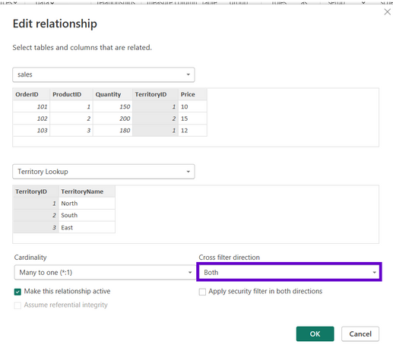
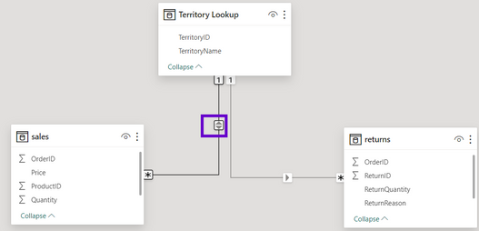



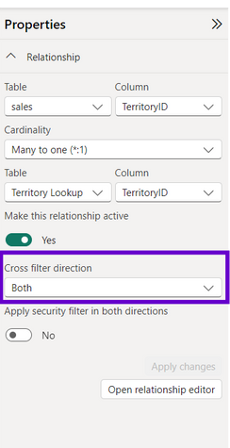
BI-DIRECTIONAL FILTERS
Have you got it?
Updating the cross-filter direction from Single to Both allows filter context to flow in either direction
In this example, filters applied to the Sales table can pass up
to the Territory Lookup table, then down to Returns

Slide 4
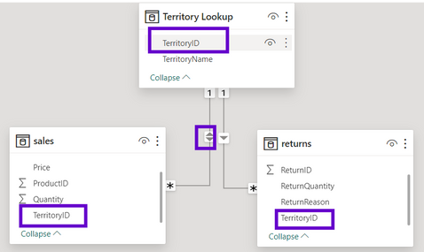

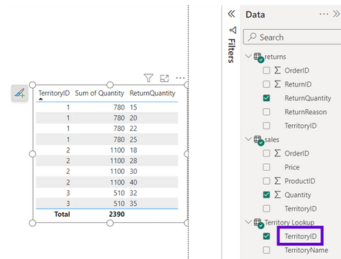
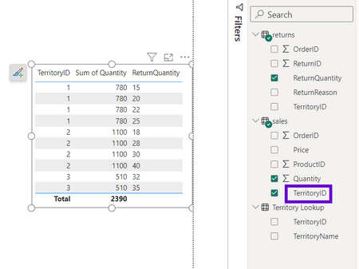
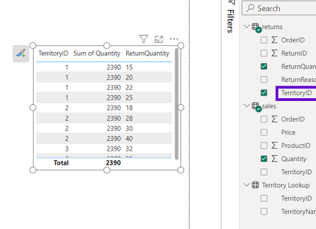
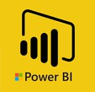
EXAMPLE: BI-DIRECTIONAL FILTERS
With two-way cross-filtering enabled between Sales and Territory,
we now see correct values using Territory Key from either table
Filter context can now pass up to the Territory Lookup table, then
downstream to Returns
However, we still see incorrect values when filtering using Territory Key from
the Returns table, since the filter context is isolated to that single table
Let’s see
with example
Filtering by Territory Lookup[Territory Key].
Which is correct
Filtering by Sales Data[Territory Key].
Which is correct
Filtering by Returns Data[Territory Key].
Which is wrong

Slide 5
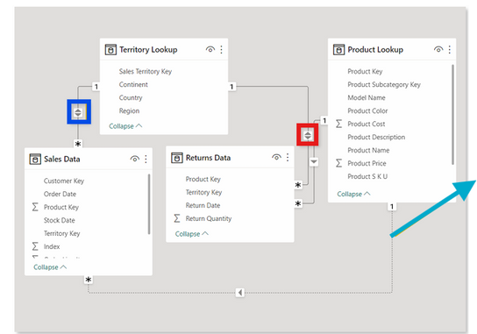


AMBIGUITY
Use two-way filters carefully, and only when necessary
Using multiple two-way filters can cause ambiguity by introducing
multiple filter paths between tables
Careful
In this example, filter context from the Product table can pass down to Returns and up to Territory Lookup, which would be filtered based on the Territory Keys passed from the Returns table
With an active relationship between Product and Sales as well, filter context could pass through either the Sales or Returns table to reach the Territory Lookup table, which could yield conflicting filter context
TIP: Design your models with one-way filters and 1:many cardinality unless more
complex relationships are absolutely necessary

Slide 6


Thank you for joining me today to learn about Part -14 of Power BI!
Remember, mastering data modeling techniques is essential for unlocking the full potential of Power BI.
Stay tuned for more insights and tips on Power BI in our next Series.
Follow
Siddhika Shah

